Slide 1

MGMT 5490 (2024)
Class 3: Learning to be non-rational
Kin Fai Ellick Wong Ph.D.
Department of Management
The Hong Kong University of Science & Technology

Slide 2

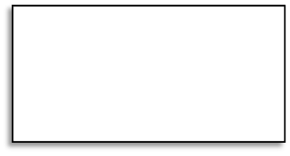
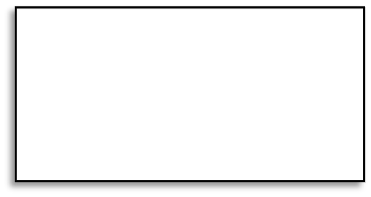

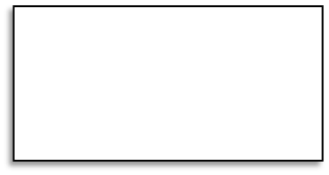
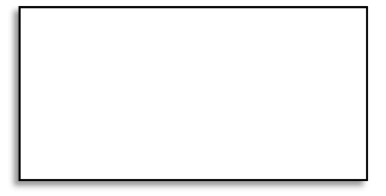


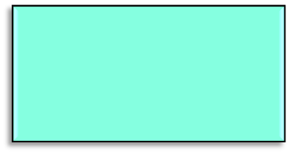

Where are we now?
Thinking, Judgment, and Rationality
Problem Solving
Perception
Specific Decision Biases
Probability Judgment
Self-Affirmation
Learning to be non-rational
Learning to be non-rational

Slide 3
Seacorner MGMT 5490 Issue 04?
Which Business Strategy Shall I Take? Selling More or Selling More Expensive
The Background:
  Formulating appropriate business strategies is very crucial to all firms. At the very early stage of her establishment, Seacorner struggled in finding what was the best business strategy for her. The actual struggling involved multiple factors and was very dynamic. You may know that in real organizational context, members in the organization are not only looking for the strategies that is most beneficial to the firm, but are also looking for the strategies that is most beneficial to themselves. In MGMT 5490 Issue 04, let us temporarily put this kind of political tension aside. Let’s assume that Seacorner members are so “pure” and are truly interested only in maximizing the benefits of the firm.

Slide 4
Seacorner MGMT 5490 Issue 04?
Which Business Strategy Shall I Take? Selling More or Selling More Expensive
The Background:
  At the very early stage, Seacorner had only very little amount of startup capital. The founders set up a maximum investment limit, which means that they would not introduce extra capital if they exhausted all the startup capital. This kind of agreement is quite common in Hong Kong startup, presumably because the failure rate of startup in Hong Kong is pretty high. Let’s assume that Seacorner had a 100-unit startup capital dedicated to getting new products from suppliers.
  At that moment (in 2009), Seacorner was just functioning as a single unit. Her business was just retails, which later evolved to be Seacorner Beauty today. Right before the startup and after the collection of the capital, a critical directional decision faced Seacorner: whether she should sell products that can be sold but with a lower profit margin (usually lower-end products), or products that are sold fewer but with a higher profit margin (usually higher-end products).

Slide 5
Seacorner MGMT 5490 Issue 04?
Which Business Strategy Shall I Take? Selling More or Selling More Expensive
The Background:
  Founders had very different views on how to use the 100 units.
  One extreme view was that Seacorner should spend all the 100 units to purchase high-end products from Supplier X. The supporting reason was primarily focusing on the high profit margins (e.g., the profit of selling one high-end product is equal to selling 10 to 15 low-end products).
  The other extreme view was that Seacorner should spend all the 100 units to purchase low-end products from Supplier Y. The supporting reason was primarily focusing on the superiority of the expected turnover of low-end products (e.g., we can earn much more by selling more).

Slide 6
Seacorner MGMT 5490 Issue 04?
Which Business Strategy Shall I Take? Selling More or Selling More Expensive
The Background:
  Here is the summary of two suppliers with products in different selling strategies:
 | Quality | Price per unit | Expected turnover | Margin
Supplier X | High-end | Quite high | Low | Very High
Supplier Y | Low-end | Very low | Very high | Low

Slide 7
Seacorner MGMT 5490 Issue 04?
Which Business Strategy Shall I Take? Selling More or Selling More Expensive
The Background:
  Of course, if the debate is just at the verbal level, there will never be any concrete answers. The Founders of Seacorner are very smart people. One founder, who majored in Biology, suggested a creative method by applying his knowledge in Charles Darwin’s most important theory: Natural Selection. For the ease of remembering, we just call this found Mr. Evolution.
  Mr. Evolution’s idea of natural selection is very simple. He proposed that at the very starting, Seacorner used 50 units of capital to purchase high-end products, and then use the remaining 50 units to purchase low-end products. Then Seacorner would do a monthly evaluation by comparing the profits from the two lines of products. If the profit of one category of product was more than the other category, then all the net profits in that particularly month would be used to purchase products from the winning category.

Slide 8
Seacorner MGMT 5490 Issue 04?
Which Business Strategy Shall I Take? Selling More or Selling More Expensive
The Background:
  For example, assume that the net profit of selling high-end products in April-2009 was 0.8 units, and that of selling low-end products was 0.2 units. The total net profit in April 2009 was 1 unit, which would all be used to purchase high-end products.
  Mr. Evolution was very satisfied with this mechanism. He justified that this mechanism can let the more profitable categories of products more likely survive. All Founders were also satisfied with this proposal.

Slide 9
Seacorner MGMT 5490 Issue 04?
Which Business Strategy Shall I Take? Selling More or Selling More Expensive
The Question:
  Question 1:
    What are the strengths of the Natural Selection mechanism proposed by Mr. Evolution?
    Do you observe any other places using similar kind of mechanisms?
  Question 2:
    What are the weaknesses of the Natural Selection mechanism?
    Is this mechanism biased? Favoring the low-end products? or High-end products?
    Anticipate what will happen after one year.

Slide 10
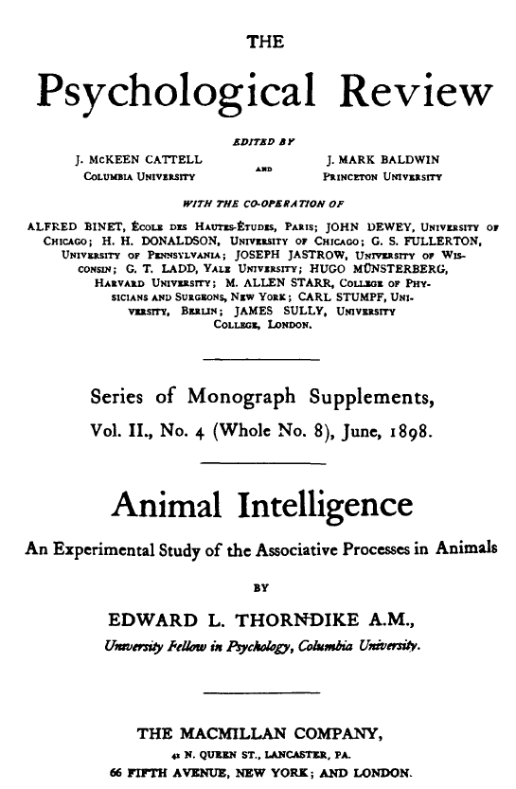
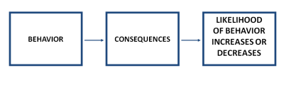
Adaptive Learning
Law of effect (Thorndike, 1898)
From: http://www.consumerpsychologist.com/cb_Learning_and_Memory.html

Slide 11
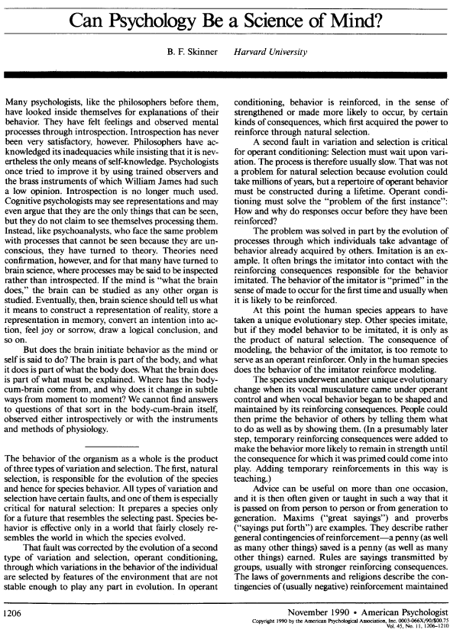
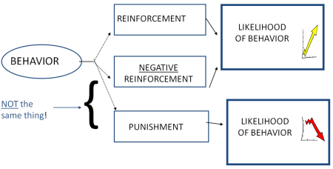
Adaptive Learning
Skinner’s operant conditioning
From: http://www.consumerpsychologist.com/cb_Learning_and_Memory.html

Slide 12
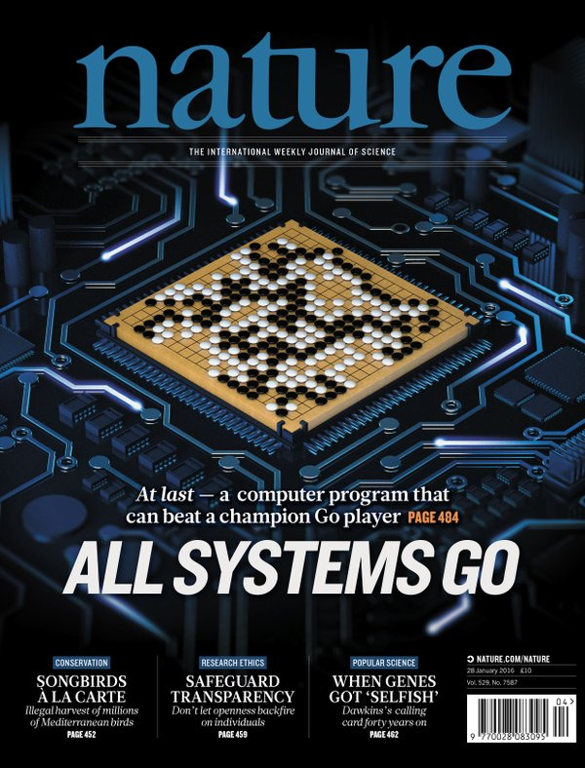
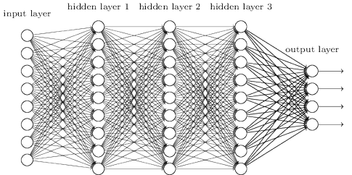
Adaptive Learning
Neural Network Learning
  E.g., AlphaGo

Slide 13
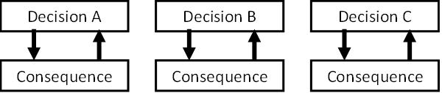
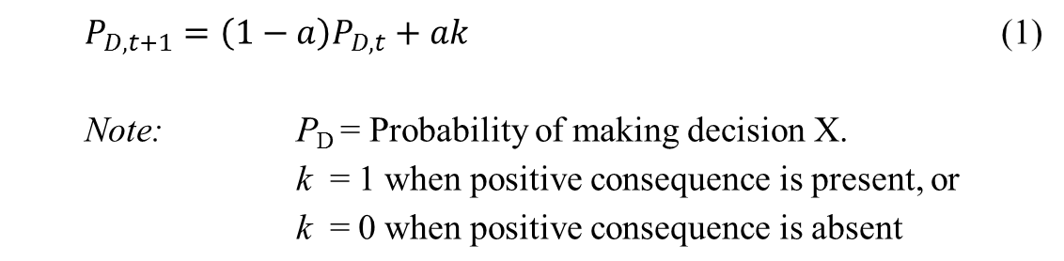
Adaptive Learning
Decision making
  March (1996)

Slide 14
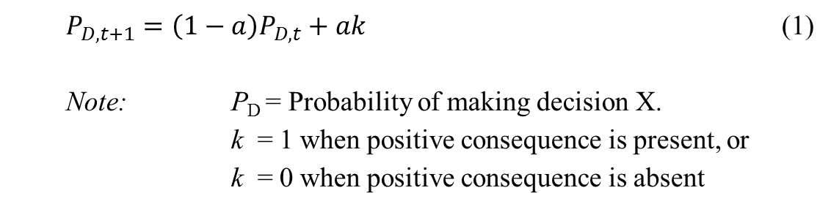
Adaptive Learning
“a” is a learning parameter
  Proportion of the newest information to regulate the next behavior
  To be adaptive, a > 0
  No learning when a = 0
  Maladaptive learning when a < 0
  One-trial learning when a = 1

Slide 15
Adaptive Learning approach of Decision making
Option A (certain)
  90% chance of getting $1
Option B (risky)
  0.1% change of getting $10,000
The Expected Utility of Option B > Option A
  Option A = (90 x 1)100 = 0.9
  Option B = (0.1 x 10000)/100 = 10

Slide 16
Adaptive Learning approach of Decision making
 | Option A (Certain) | Option B (Risky)
Probability | 90% | 0.1%
Reward | $1 | $10,000
Expected Utility | 0.9 | 10
Starting Likelihood of being chosen | 0.5 | 0.5
Probability of being reinforced at the very beginning | Very high | Very low
Probability of choosing again | Increasing over time | Decreasing over time
Subjective favorability | Overestimate its subjective favorability | Underestimate its subjective favorability
Results | Bias toward Option A

Slide 17
Adaptive Learning approach of Decision making
Explaining negative attitude against minority group people but not majority group people
  Your experience of meeting a new friend from a majority group
 | Positive Experience/ Overestimating | Negative Experience/ Underestimating
Probability of proactively meeting people from the same group again | Higher than before | Lower than before
Probability of passively meeting people from the same group again | Very high because they are majority | Very high because they are majority
Outcome | Correcting the overestimation due to regression to mean with more samples | Correcting the underestimation due to regression o mean with more samples

Slide 18
Adaptive Learning approach of Decision making
Explaining negative attitude against minority group people but not majority group people
  Your experience of meeting a new friend from a minority group
 | Positive Experience/ Overestimating | Negative Experience/ Underestimating
Probability of proactively meeting people from the same group again | Higher than before | Lower than before
Probability of passively meeting people from the same group again | Very low because they are minority | Very low because they are minority
Outcome | Correcting the overestimation due to regression to mean with more samples from proactively meeting | Difficult to correct the underestimation due to low in both proactive and passive sampling

Slide 19
Adaptive Learning approach of Decision making
“Common to all preceding paradigms is the premise that the origin of bias lies within the individual’s motives and cognitive shortcomings (cf. Nisbett and Ross 1980). The bias within the individual exits prior to the sampling process… In contrast, the present approach highlights biases resulting from sampling processes… Moreover, the sampling process need not be similar to, or reflect the same motives and reasons as, the judgment bias it produces.”
(Fiedler, 2000, p.659, Psychological Review).
Being adaptive could be non-rational (e.g., violating maximization)

Slide 20
Seacorner MGMT 5490 Issue 04?
Which Business Strategy Shall I Take? Selling More or Selling More Expensive
The Question:
  Question 1:
    What are the strengths of the Natural Selection mechanism proposed by Mr. Evolution?
    Do you observe any other places using similar kind of mechanisms?
  Question 2:
    What are the weaknesses of the Natural Selection mechanism?
    Is this mechanism biased? Favoring the low-end products? or High-end products?
    Anticipate what will happen after one year.

Slide 21
Seacorner MGMT 5490 Issue 04?
Which Business Strategy Shall I Take? Selling More or Selling More Expensive
The suggestion:
  The “Natural-Selection” mechanism would led Seacorner toward selling more High-end products.
  The key learning message from this exercise is that although from the “learning to be non-rational” class, we know that people generally will learn to be risk averse through adaptive learning, there are some specific circumstances where people will learn to be more likely to take risk. Students who are interested in understanding the logic of learning to be risk averse, please read March (1996) and Erev & Baron (2005).
  One of these circumstances is when we set a “biased winning rule”. Let’s consider this biased winning rule using the following hypothetical monthly information:

Slide 22
Adaptive Learning approach of Decision making
 | Low-end Product | High-end Product
Starting Capital | $50,000 | $50,000
Cost per unit | 20 | 200
Sell price per unit | 40 | 867
Expected number of selling (hidden to Seacorner) | Mean = 250, SD =25 Expected = 250 | Randbetween 0 to 15 Expected = 7.5
Expected sales revenue | 250 x $40 = $10,000 | 7.5 x $866 = 6,495
Expected costs | 250 x $20 = $5,000 | 7.5 x $200 = $1,500
Expected profits | $10,000 - $5,000 = $5,000 | $6,495 - $1,500 = $ 4,995
Results | Keep just doing low-end or high-end, roughly the same

Slide 23
Seacorner MGMT 5490 Issue 04?
Which Business Strategy Shall I Take? Selling More or Selling More Expensive
The suggestion:
  You can see that the expected monthly profits between selling these two kinds of products are roughly the same. Because the selling of the low-end products is very stable, we expect that the expected profit of $5, 000 by selling the low-end products is also quite stable too. However, the selling of the high-end products is very unstable (i.e., more variation), Thus, when high-end products lose, it contributed very small amount of profits to buy the low-end products. Thus, the newly added capital to low-end products is likely to be $5,000 + <$5,000. When high-product wins, it must be > $5,000. Thus, the newly added capital to high-end products is likely to be $5,000 + >$5,000.
  To further verify this logic, I prepared an Excel File of simulation. I’ll also upload this to our CANVAS

